Slide 1
Normal Reference Range in Medicine and Skewed Distributions
Richard B. Goldstein, Ph.D.
Professor of Mathematics (ret.)
Providence College
Courtesy Professor of Mathematics at FGCU

Slide 2
Normal Reference Range :
the set of values in which 95% of the normal population falls within (that is, a 95% prediction interval). It is determined by collecting data from typically over one hundred tests from normal patients.

Slide 3
Descriptive Statistics

Slide 4
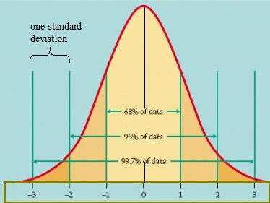
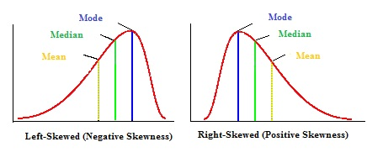
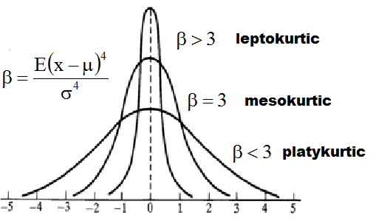

Slide 5
Common Methods used to calculate the Normal Reference Range
Sample mean ± 2 standard deviations
Percentiles of Raw Data
Using general power transformations to create a Normal/Gaussian Distribution
Curve fitting of data in histogram format by various skewed distributions
Dissecting distributions that contain mixed normal and abnormal populations

Slide 6
Near Gaussian Shaped Data

Slide 7
Some Raw Data – Creatinine (mg/dl) for 100 healthy males
# | Creatinine | # | Creatinine | # | Creatinine | # | Creatinine | # | Creatinine
1 | 0.90 | 21 | 0.97 | 41 | 1.01 | 61 | 1.04 | 81 | 1.09
2 | 0.91 | 22 | 0.98 | 42 | 1.01 | 62 | 1.05 | 82 | 1.09
3 | 0.91 | 23 | 0.98 | 43 | 1.01 | 63 | 1.05 | 83 | 1.10
4 | 0.92 | 24 | 0.98 | 44 | 1.01 | 64 | 1.05 | 84 | 1.10
5 | 0.93 | 25 | 0.98 | 45 | 1.02 | 65 | 1.05 | 85 | 1.10
6 | 0.93 | 26 | 0.98 | 46 | 1.02 | 66 | 1.05 | 86 | 1.10
7 | 0.94 | 27 | 0.99 | 47 | 1.02 | 67 | 1.06 | 87 | 1.11
8 | 0.94 | 28 | 0.99 | 48 | 1.02 | 68 | 1.06 | 88 | 1.11
9 | 0.94 | 29 | 0.99 | 49 | 1.02 | 69 | 1.06 | 89 | 1.11
10 | 0.95 | 30 | 0.99 | 50 | 1.03 | 70 | 1.06 | 90 | 1.12
11 | 0.95 | 31 | 0.99 | 51 | 1.03 | 71 | 1.07 | 91 | 1.12
12 | 0.96 | 32 | 1.00 | 52 | 1.03 | 72 | 1.07 | 92 | 1.13
13 | 0.96 | 33 | 1.00 | 53 | 1.03 | 73 | 1.07 | 93 | 1.13
14 | 0.96 | 34 | 1.00 | 54 | 1.03 | 74 | 1.07 | 94 | 1.13
15 | 0.96 | 35 | 1.00 | 55 | 1.03 | 75 | 1.08 | 95 | 1.14
16 | 0.97 | 36 | 1.00 | 56 | 1.03 | 76 | 1.08 | 96 | 1.15
17 | 0.97 | 37 | 1.00 | 57 | 1.04 | 77 | 1.08 | 97 | 1.15
18 | 0.97 | 38 | 1.00 | 58 | 1.04 | 78 | 1.08 | 98 | 1.16
19 | 0.97 | 39 | 1.00 | 59 | 1.04 | 79 | 1.09 | 99 | 1.17
20 | 0.97 | 40 | 1.01 | 60 | 1.04 | 80 | 1.09 | 100 | 1.19

Slide 8
Using $\overline{x}±1.96s$ on Raw Data
The n sample values are used to find the sample statistics:

Slide 10
Using Percentiles on Raw Data
The n sample values are sorted:
Method I (used by Excel and Quattro Pro for example)

Slide 11
Method II (used by SPSS and known as Tukey’s Hinges)
[a] if k(n + 1) < 1 then use r = 1
[b] if k(n + 1) > n then use r = n
[c] otherwise interpolate using r = k(n + 1)
Using this method the normal range is 0.910 to 1.165
The National Committee for Clinical Laboratory Standards accepted the use of percentiles as an optional method for determining a normal range which was proposed by L. Herrera.

Slide 13
ERRORS IN CLINICAL LABORATORIES
Variations between laboratories
Variation between analysts (same laboratory site)
Day-to-day variations (same analyst, laboratory, and sample)
Variations between replicates (same analysis)

Slide 14
CONVOLUTION (sum of random variables)
Z = X + Y
X has probability density function f(x)
Y has probability density function g(x)
Z has probability density function h(x)
Example: Exponential and Normal Distributions

Slide 15
Skewed Distributions for Fitting Data
Gram – Charlier Series
Pearson System of Distributions
N.L. Johnson System of Distributions
Skew-Normal Distribution

Slide 16
Gram-Charlier Series
Problems:
f(x) is negative for part of the interval
f(x) is bimodal for high skewness

Slide 17
Karl Pearson System of Distributions
Problems:
Difficulty in finding percentiles
Some complicated forms

Slide 18
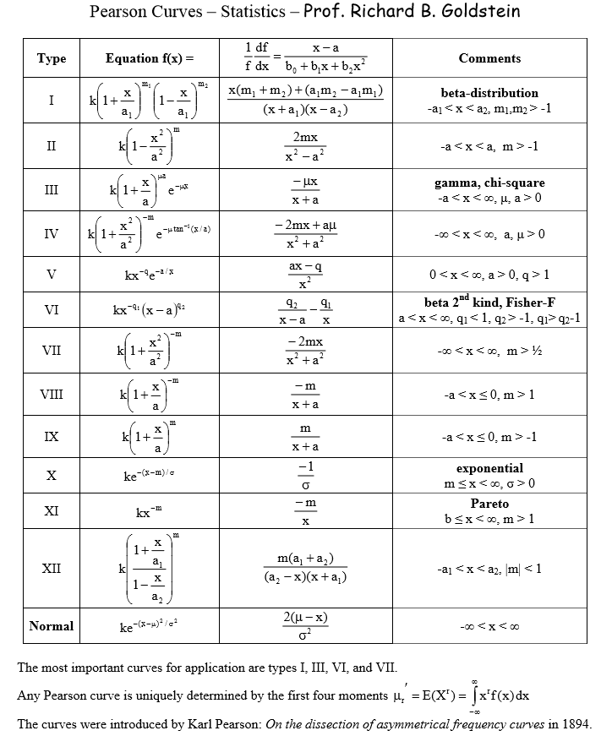

Slide 19
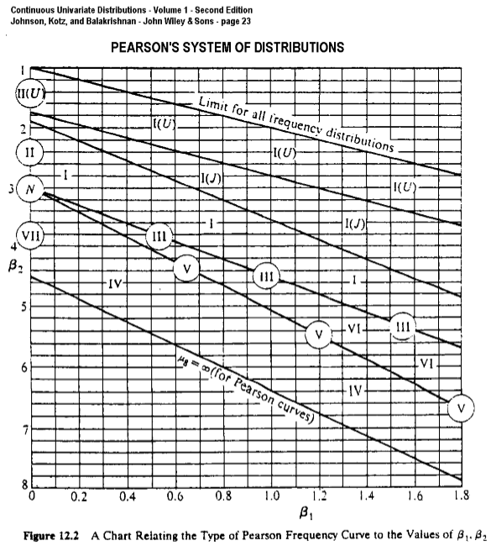

Slide 20
N.L. Johnson System of Probability Distributions

Slide 21
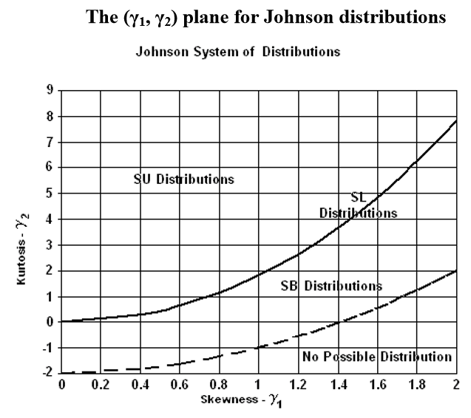

Slide 22
Highly Skewed Distribution – A1c/Glycated Hemoglobin
x | freq
3.25 | 1
3.75 | 5
4.25 | 17
4.75 | 110
5.25 | 183
5.75 | 102
6.25 | 23
6.75 | 10
7.25 | 4
7.75 | 4
8.25 | 2
8.75 | 2
9.25 | 1
9.75 | 2
10.25 | 2
10.75 | 1
11.25 | 3
11.75 | 0
12.25 | 1
12.75 | 1
TOTAL | 474

Slide 23
First Fit
Sum Sq = 175.4
P_{0.95} = 6.06
Standard:
4% to 5.6% : Normal
5.7% to 6.4% : Pre-Diabetic
6.5% or more : Diabetic

Slide 24
Was this a set of healthy individuals only? Can we remove some abnormals/unhealthy?

Slide 25
Dissected result using Johnson SU & Gaussian
Dissection f_{Tot} (x)= w₁f₁(x) + w₂f₂(x)
Sum of squares now 56.71
Approximately 89% of values are healthy (normal) individuals
Approximately 11% of values are from unhealthy (abnormal) individuals
The 90th percentile is 5.82
The 95th percentile is 5.98
Standard (from sources):
4% to 5.6% : Normal
5.7% to 6.4% : Pre-Diabetic
6.5% or more : Diabetic

Slide 26
Dissection using two Johnson SU distributions

Slide 27
Dissected result using 2 Johnson SU Distributions
Sum of squares now 37.73
Approximately 91% of values are healthy individuals
Approximately 9% of values are from unhealthy individuals
The 90th percentile is 5.82
The 95th percentile is 5.99
Almost identical to using Johnson SU with Gaussian
Note crossover at 6.4 where we minimize the sum of the false positives and false negatives

Slide 28
Comparisons for A1c
Method | Sum of Sqs | 95th Percentile
Simple Normal +1.645s |  | 7.25
Single Johnson SU fit | 175.4 | 6.06
Dissection Johnson SU & Gauss | 56.7 | 5.98
Dissection 2 Johnson SU | 37.7 | 5.99
Current Standard Prediabetic |  | 5.60
Current Standard Diabetic |  | 6.50

Slide 29
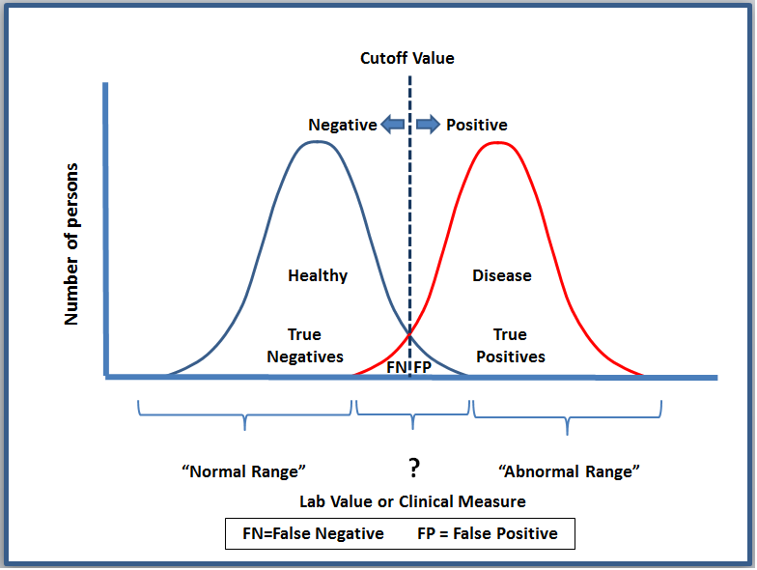

Slide 30
Highly Skewed Data with Outliers

Slide 31
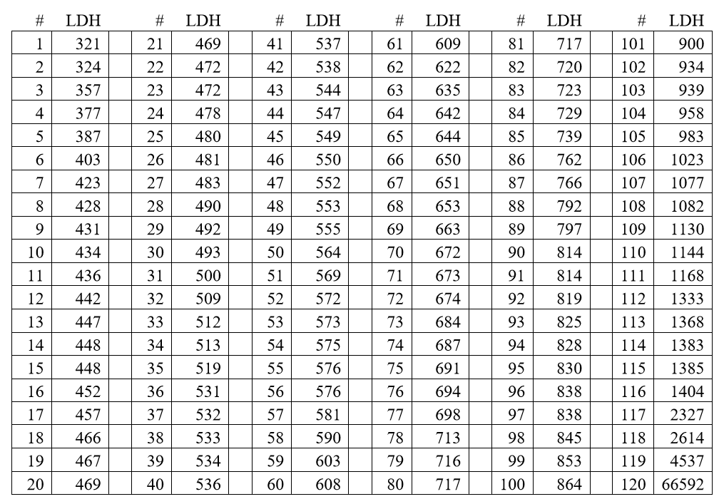
Some Raw Data – Lactate Dehydrogenase (IU/L) – Female Children

Slide 32
Box-Cox Transformation
One way to determine, λ is to select the value of λ that maximizes the logarithm of the likelihood function (LLF):

Slide 34
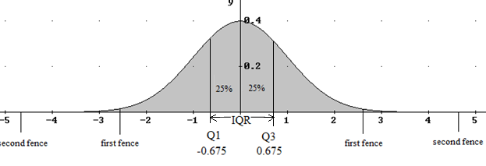
OUTLIERS in a Normal Distrubtion
Prof. John Tukey’s Exploratory Data Analysis
First Fence beyond [Q₁-1.5*IQR] = -2.698 or [Q₃+1.5*IQR] = 2.698
about 0.698% totally – use symbol ^{о}
Second Fence beyond [Q₁-3*IQR] = -4.721 or [Q₃+3*IQR] = 4.721
about 0.00023% totally – use symbol ^{Ж}
For LDH where the 1st fence is 1287.6 and 2nd fence is 1761.2 there are 9 outliers of which 4 are extreme outliers – this is too many!

Slide 35
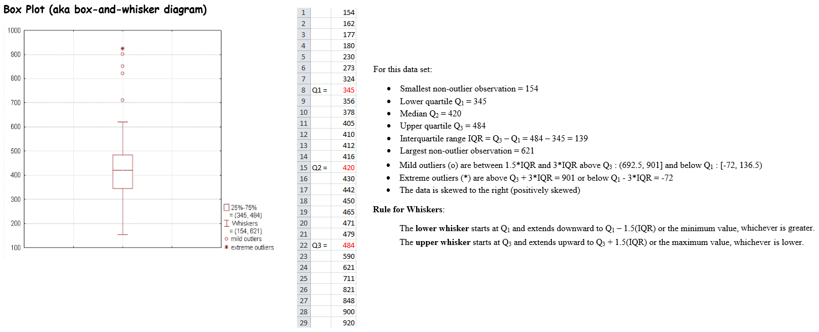
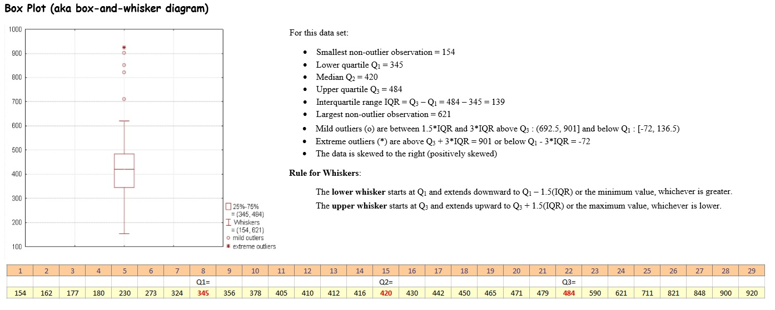
Outliers using John W. Tukey’s Box Plot

Slide 36
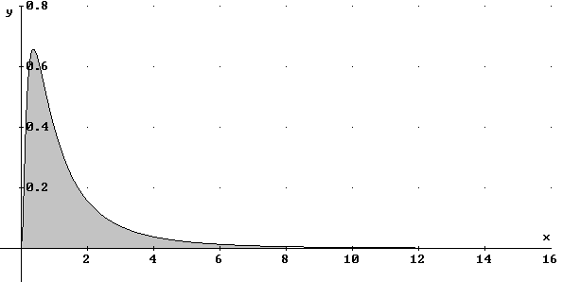
Outliers for a lognormal distribution
Here Q₁ = 0.509, Q₃ = 1.963 and the 1st fence is 4.143 and 2nd is 6.329. Using Tukey’s fences 7.76% of the values are beyond the 1st fence and 3.26% are beyond 2nd fence.
For LDH if the top 2 values (4537 and 66592) are dropped, then the 1st fence is at 2873 and there would be no further outliers to remove. An outlier should be errors in measurement or extremely unlikely events.
Conclusion: Don’t use Tukey’s fences for very skewed data.
Suggestion: Transform data closer to Normal and then use Tukey’s fences to remove outliers.

Slide 37
P_{2.5} = 375
P_{97.5} = 1432
Note:
4 values not fitted are
2327, 2614, 4537, and 66592

Slide 38
Comparisons for LDH
Method | 95% Reference Interval with all 120 LDH values | 95% Reference Interval with 116 LDH values
Nonparametric | (376, 2334) | (375, 1370)
Traditional Normal | (0, 13271) | (194, 1138)
Transformed Normal | (351, 1730) | (366, 1351)
Least Sq fit by Johnson SU | (305, 1104) | (375, 1432)
Traditional Normal:
LDH Data Source: Reference Intervals: A User’s Guide by Horn & Pesce – AACC Press 2005

Slide 39
Cholesterol Data from the Framingham (MA) Heart Study
# | Chol | # | Chol | # | Chol | # | Chol
1 | 167 | 17 | 226 | 33 | 246 | 49 | 270
2 | 184 | 18 | 230 | 34 | 247 | 50 | 272
3 | 192 | 19 | 230 | 35 | 248 | 51 | 278
4 | 198 | 20 | 230 | 36 | 254 | 52 | 278
5 | 200 | 21 | 230 | 37 | 254 | 53 | 283
6 | 202 | 22 | 231 | 38 | 254 | 54 | 285
7 | 210 | 23 | 232 | 39 | 256 | 55 | 300
8 | 211 | 24 | 232 | 40 | 256 | 56 | 300
9 | 212 | 25 | 232 | 41 | 258 | 57 | 308
10 | 215 | 26 | 234 | 42 | 263 | 58 | 327
11 | 216 | 27 | 234 | 43 | 264 | 59 | 334
12 | 217 | 28 | 236 | 44 | 267 | 60 | 336
13 | 218 | 29 | 236 | 45 | 267 | 61 | 353
14 | 220 | 30 | 238 | 46 | 267 | 62 | 393
15 | 225 | 31 | 240 | 47 | 268
16 | 225 | 32 | 243 | 48 | 270

Slide 40
The Heart Study began in 1948 by recruiting an Original Cohort of 5,209 men and women between the ages of 30 and 62 from the town of Framingham, Massachusetts, who had not yet developed overt symptoms of cardiovascular disease or suffered a heart attack or stroke.
Assuming the above data came from healthy individuals then p₉₅ = 334. This is way above current standards:
Total Cholesterol Level | Category
Less than 200 MG/DL | Desirable
200-239 MG/DL | Borderline High
240 MG/DL and above | High

Slide 41
Tests for Normality
Tests to Consider
[1] Chi-Square Goodness-of-Fit Test
[2] Graphics – Normal Probability Plot
[3] Non-Parametric Kolmogorov-Smirnov Test
[4] Geary’s Test for Normal Distribution
[5] D’Agostino-Belanger-Pearson’s Skewness, Kurtosis, and Omnibus Tests
[6] Others – Shapiro-Wilk, Anderson-Darling, Cramér-von Mises Tests

Slide 42
Other considerations
Use of powers and other transforms
Other distributions
Fitting by first 4 moments (Pearson system) vs. Least Squares
Confidence Intervals for predictions
Jackknife method or Resampling/Bootstrapping to get confidence intervals

Slide 43
Mathematicians who contributed
Karl Friedrich Gauss 1777-1855 Germany
Joseph Gram 1850-1916 Denmark
Carl Charlier 1862-1934 Sweden
Karl Pearson 1857-1936 UK
William S. Gosset (Student) 1876-1937 UK
Norman Lloyd Johnson 1917-2004 UK/USA
George Box 1919-2000 UK/USA
David Cox 1924- UK/USA
John W. Tukey 1915-2000 USA

Slide 44
Dedicated to Prof. Horace F. Martin
1931-2010
B.S. - Providence College 1953
M.S. - University of Rhode Island 1955
Ph.D. - Boston University 1961
M.D. - Brown University 1975
J.D. - S. New England Sch. of Law 1990
M.P.H. - McGill University 2000

Slide 45
Thank You Florida Gulf Coast University

