Slide 1
Dynamic Models of the Oral Glucose Tolerance Test
Prof. Richard B. Goldstein (Ret.)
Dept. of Math. and Comp. Sci.
Providence College

Slide 2
Glucose diagnostic test
blood sample collected when you arrive called your fasting blood glucose value
drink a sweet liquid containing 75 to 100 grams of glucose
blood samples are collected 6 to 14 times for up to 5 hours

Slide 3
1 Adult Onset Diabetes Mellitus (NIDD) 2 Malabsorption or Drug Effect 3 Normal 4 Normal Obese 5 NIDD on "the Pill" 6 Normal on "the Pill" 7 Juvenile Diabetics (Type I) 8 Normal Obese on "the Pill"
9 Acromegalics 10 Antibodies 11 “Dumping Syndrome” 12 Hypothyroid 13 Insulinoma 14 Hypocorticism 15 Ileal By-pass Malabsorption 16 Panhypopituitarism

Slide 4
GOAL
Develop a dynamic model for the regulation of blood glucose

Slide 5
Requirements for OGTT Model
It is clinically based (i.e. be applied to clinical data).
It has statistically significant parameters.
It should be both numerically and visually a good fit.
It has statistically significant variations among various disease states.
The number of parameters should be as small as possible.

Slide 6
APPLIED MATHEMATICS USED
NUMERICAL ANALYSIS
(1) Interpolation – linear or cubic spline
(2) Curve Fitting – using least squares principle
(3) Optimization Methods
(4) Numerical Solutions to System of ODE
LINEAR ALGEBRA
(1) Eigenvalues and Vectors
(2) Singular Value Decomposition
STATISTICS
(1) Step-Up Non-Linear Regression
(2) Significance of Statistics used in models
(3) Hypothesis Testing – ANOVA, Kruskal-Wallis
COMPUTER PROGRAMMING

Slide 7
Normal Non-Obese Female

Slide 9
Female - Diabetes Mellitus (IDDM Type)

Slide 11
Classifications
CLASS | CHARACTERISTICS | DEMOGRAPHICS
 |  | SEX NUM |  | AGE Years | HEIGHT Inches | WEIGHT Pounds
Normal | 1. FBS 65-105 mgs/dl 2. Fasting Insulin < 25 µU/ml 3. Maxima of Glucose and Insulin in synchrony 4. Off all medications 5. Insulin @ 5 hrs. at or < fasting 6. Insulin is effective in lowering fasting FFA by 50% 7. Fasting HGH and Cortisol lowered during after glucose load 8. No glucosuria and no ketomuria 9. Control index is 16.8 - 54.6 | M F | 25 16 | 32.5 ± 14 40.7 ± 17 | 69.6 ± 2.6 63.4 ±3.8 | 188 ±67 179 ± 69
“Flat” | 1. Relative to fasting glucose blood levels (FBS), the rise is < 20 mgs/dl over the entire 5 hours 2. Control Index is < 16.8 | M F | 16 41 | 38.0 ± 17 36.6 ± 11 | 69.1 ± 4.0 64.0 ± 2.2 | 169 ± 42 158 ± 44
Diabetes Type 2 | 1. Elevated FBS and failure to return to FBS levels after 5hrs. 2. Two consecutive levels >140 mgs/dl 3. Asynchronous Glucose and Insulin maxima 4. Off all medications 5. Control Index is > 54.6 | M F | 9 16 | 58.4 ± 13 56.0 ± 16 | 68.4 ± 3.5 62.9 ± 2.6 | 190 ± 49 179 ± 51
Legend: FBS= Fasting Blood Sugar; HGH= Human Growth Hormone and FFA= Free Fatty Acids.

Slide 12
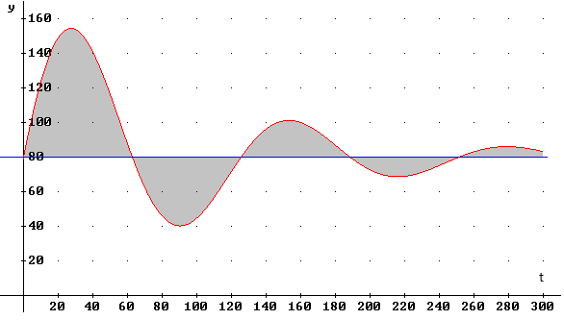
Glucose Control Index
CI Normal Reference Range: 16.8 to 54.6

Slide 13
Linear System of ODEs
with
Constant Coefficients

Slide 15
Eigenvalues of Matrix A
• Distinct Real Eigenvalues λ₁≠λ₂
• Repeated Real Eigenvalues λ₁=λ₂
• Complex Conjugates α±βi

Slide 16
Ackerman Model - 1964
where g(t) = G(t) - G(0)
h(t) = H(t) - H(0)

Slide 18
Ackerman Model
a major contribution
incomplete for purposes beyond three hours - in a normal individual after three hours the glucose often drops below baseline and is restored by the concerted action of human growth hormone (HGH), glucagon, and cortisol
Celeste, Ackerman, et. al. added glucagon to a later model

Slide 19
Other Models
Atkins: 24 models with glucose, insulin
used linear, exponential, hyperbolic terms
Srinivasan: 30 parameters, 12 initial conditions
Banks and 44 parameters for one patient
Carter: used piecewise linear, step functions, etc.
Lehmann AIDA - used only glucose with estimates
and Deutsch: based upon food and insulin intake

Slide 20
Martin and Goldstein Model #1
GN, HGH, and CT are given by interpolated tables
g_{G}(t) is variable for each time point

Slide 21
Variations of Model #1
time delays such as h(t - c₉) and g_{B}(t - c₁₀)
double exponential release of glucose
truncated normal or chi-square shaped curve for release of glucose

Slide 22
Martin and Goldstein Model #2
J(t) determined at each time point
If GN(t) missing, no a₃ term

Slide 23
Definitions
a₂ rate of transfer of glucose from blood to the tissues
b₁ rate of transfer inactive insulin to active insulin with its release into blood
b₂ rate of transfer of inactivation of insulin
J(t) emptying from the gastro-intestinal compartment to the blood
GN(t) Glucagon at time t, if known

Slide 24
Steps to find optimal curve fit
(1) Start with an initial set of values for the constant coefficients (parameters).
(2) Solve the ODE system numerically.
(3) Calculate the model’s values for glucose and insulin.
(4) Measure goodness-of-fit by least sum of squares for glucose and insulin.
(5) Improve the fit by changing the parameters.
(6) Redo steps (2) to (5) until satisfied.

Slide 25
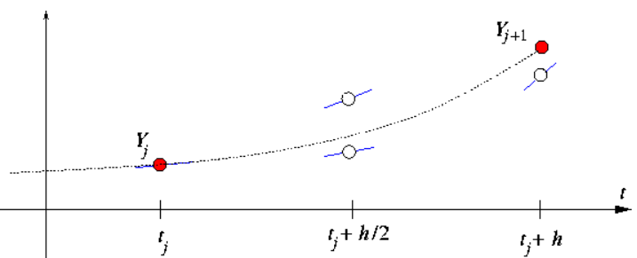
Runge-Kutta approximation

Slide 26
Non-linear least squares

Slide 27
Non-linear least squares
Methods:
Gradient - Steepest Descent
Rosenbrock
Gauss-Newton
Levenberg-Marquardt
Broyden-Fletcher-Goldfarb-Shannon
(BFGS) Method

Slide 28
Gradient - Steepest Descent
Steps are taken in the direction of the
minimum based upon the gradient.
Often slows down and ziz-zags

Slide 29
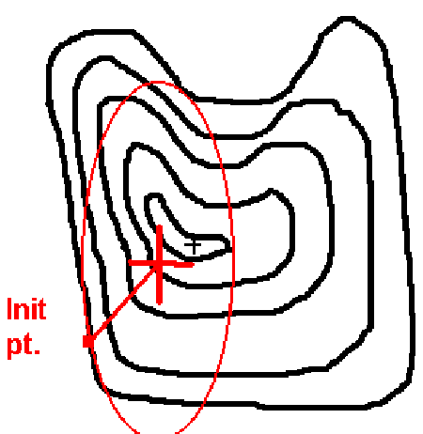
Gauss - Newton Method
Steps are taken in the direction of the
minimum based upon ellipsoid center.

Slide 30
Levenberg - Marquardt
Newton:
Gauss-Newton:
L-M method:
The value of μ_{k} is adjusted as it converges.
μ_{k} = 0 is Gauss-Newton method
μ_{k} →∞ is gradient / steepest descent method

Slide 31
Other Methods
Rosenbrock: Good for starting
Robust and stable
BFGS: Adjusts J^{T}J rather
than recalculating
each step
Hybrids: Mixtures of several
methods

Slide 32
Program Options
Rosenbrock
Pure Marquardt
with or without a linear search
Mix of Marquardt & BFGS
with or without a linear search
Pure BFGS
requires a linear search

Slide 33
Singular Value Decomposition
U is an m by n orthogonal matrix
D is a diagonal matrix
V is an n by n orthogonal matrix
Useful for stability in Gauss-Newton’s method

Slide 34
Fitting Real Patient Data
Normal
MD is female, 30, 64”,115 lbs.
Diabetic – Type I (IDDM)
MY is female, 63, 212 lbs.
Diabetic – Type II (NIDDM)
FND is female
Flat
KC is female, 28, 112 lbs.

Slide 35
Normal Non-Obese Female (MD)

Slide 36
Normal Female (MD CI=24.67)
Ackerman Model #1
Sum of Squares = 3,769 + 4,701 = 8,470

Slide 37
Normal Female (MD)
Ackerman Model #2
Sum of Squares = 10,780 + 3,667 = 14,447

Slide 38
Normal Female (MD)
M/G Model #2, no Glucagon
Sum of Squares = 998 + 364 = 1,367

Slide 39
Normal Female (MD)
M/G Model #2 with Glucagon
Sum of Squares = 647 + 165 = 812

Slide 40
IDDM (patient MY : CI=105.9)

Slide 41
IDDM (patient MY : CI=105.9)
Ackerman Model #1
a₁ = 23.70
a₂ = -65.55
b₁ = 9.10
b₂ = -25.09
B = 215.1
Sum Sqs = 940.2

Slide 42
IDDM (patient MY : CI=105.9)
M/G Model #2 no Glucagon
a₂ = -5.61
b₁ = 3.59
b₂ = -10.59
Sum Sqs = 748.3

Slide 43
NIDD – FND2, CI=74.77

Slide 44
NIDD – FND2, CI=74.77
Ackerman Model #1
a₁ = 45.45
a₂ = -66.09
b₁ = 32.29
b₂ = -46.93
B = 158.08
Sum Sqs = 2,449
Real : -23.5
Imag : 39.8

Slide 45
NIDD – FND2, CI=74.77
M/G Model #2 no Glucagon
a₂ = -4.157
b₁ = 6.691
b₂ = -11.565
Sum Sqs = 275.5

Slide 46
Flat (patient KC : CI=11.45)

Slide 47
Flat (patient KC : CI=11.45)
Ackerman Model #1
a₁ = -6.163
a₂ = -3.959
b₁ = 1.900
b₂ = 0.091
B = 3810.8
Sum Sqs = 1889
Real : 0.0457
Imag : 2.738

Slide 48
Flat (patient KC : CI=11.45)
M/G Model #2, no glucagon
Sum Sqs = 663.2
a₂ = -4.15
b₁ = 20.31
b₂ = -3.24
Real : -1.62
Imag : 9.04

Slide 49
Non-linear least squares
Initial Values
c₁ = 80
c₂ = 100
c₃ = 0.01
c₄ = 0.05
c₅ = 0.01
Sum Sqs=4,662

Slide 50
Non-linear least squares
Final Values
c₁ = 84.2787
c₂ = 118.9521
c₃ = 0.0182
c₄ = 0.0392
c₅ = -0.0299
Sum Sqs=1,715

Slide 51
Roots of the polynomial for females
Type of Patient | Imaginary | Real
Flat (n = 11) | 8.592 | -2.223
Normal (n = 9) | 5.531 | -2.979
Diabetic (n = 10) | 4.064 | -4.763
Normal Obese (n = 8) | 6.502 | -1.412

Slide 52
Statistical Results for females
Imaginary Term (for 3 groups)
ANOVA p = 2.54 x 10⁻⁸
Kruskal-Wallis p = 1.71 x 10⁻³
Real Term (for 3 groups)
ANOVA p = 0.0434
Kruskal-Wallis p = 2.54 x 10⁻³
Note: using t-test - obese not different from normal for either term

Slide 53
Roots of the polynomial for males
Type of Patient | Imaginary | Real
Flat (n = 16) | 8.261 | -1.867
Normal (n = 12) | 10.821 | -4.345
Diabetic (n = 9) | 3.134 | -2.803

Slide 54
Statistical Results for males
Imaginary Term (for 3 groups)
ANOVA p = 3.69 x 10⁻⁹
Real Term (for 3 groups)
ANOVA p = 0.0173
Note: using t-test – male vs. female normal - imaginary terms higher in male
diabetics - real terms were lower

Slide 55
Statistical Significance of Parameters
a₂ higher in female obese p = 0.0096
b₁ higher in female obese p = 0.034
b₂ slightly higher p = 0.129 for obese
b₂ was most different of the parameters in the 3 groups
p = 0.0173 for males
p = 0.0152 for females

Slide 56
Statistical Significance
t-test for each parameter
Gauss’
Criterion
Step-up regression:
Each variable added is tested for
significance to the model

Slide 57
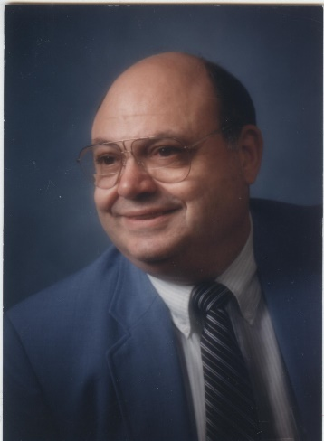
Dedicated to Prof. Horace F. Martin
1931-2010
B.S. - Providence College 1953
M.S. - University of Rhode Island 1955
Ph.D. - Boston University 1961
M.D. - Brown University 1975
J.D. - S. New England Sch. of Law 1990
M.P.H. - McGill University 2000

Slide 58
Thank You Florida Gulf Coast University

